Slide 1
Merge Sort
7 2 ⏐ 9 4 → 2 4 7 9
7 ⏐ 2 → 2 7
9 ⏐ 4 → 4 9
7 → 7
2 → 2
9 → 9
4 → 4

Slide 2
We will look at this table later …
Algorithm | Time | Notes
selection-sort | O(n²) | slow in-place for small data sets (< 1K)
insertion-sort | O(n²) | slow in-place for small data sets (< 1K)
heap-sort | O(n log n) | fast in-place for large data sets (1K — 1M)
merge-sort | O(n log n) | fast sequential data access for huge data sets (> 1M)

Slide 3
New things that we will learn from this part
Divide-and-Conquer rationale
Complexity analysis based on recurrence relation

Slide 4
Execution Example
Partition
7 2 9 4 ⏐ 3 8 6 1 → 1 2 3 4 6 7 8 9
7 2 9 4 → 2 4 7 9
3 8 6 1 → 1 3 8 6
7 2 → 2 7
9 4 → 4 9
3 8 → 3 8
6 1 → 1 6
7 → 7
2 → 2
9 → 9
4 → 4
3 → 3
8 → 8
6 → 6
1 → 1

Slide 5
Execution Example (cont.)
Recursive call, partition
7 2 9 4 ⏐ 3 8 6 1 → 1 2 3 4 6 7 8 9
7 2 ⏐ 9 4 → 2 4 7 9
3 8 6 1 → 1 3 8 6
7 2 → 2 7
9 4 → 4 9
3 8 → 3 8
6 1 → 1 6
7 → 7
2 → 2
9 → 9
4 → 4
3 → 3
8 → 8
6 → 6
1 → 1

Slide 6
Execution Example (cont.)
Recursive call, partition
7 2 9 4 ⏐ 3 8 6 1 → 1 2 3 4 6 7 8 9
7 2 ⏐ 9 4 → 2 4 7 9
3 8 6 1 → 1 3 8 6
7 ⏐ 2 → 2 7
9 4 → 4 9
3 8 → 3 8
6 1 → 1 6
7 → 7
2 → 2
9 → 9
4 → 4
3 → 3
8 → 8
6 → 6
1 → 1

Slide 7
Execution Example (cont.)
Recursive call, base case
7 2 9 4 ⏐ 3 8 6 1 → 1 2 3 4 6 7 8 9
7 2 ⏐ 9 4 → 2 4 7 9
3 8 6 1 → 1 3 8 6
7 ⏐ 2 → 2 7
9 4 → 4 9
3 8 → 3 8
6 1 → 1 6
7 → 7
2 → 2
9 → 9
4 → 4
3 → 3
8 → 8
6 → 6
1 → 1

Slide 8
Execution Example (cont.)
Recursive call, base case
7 2 9 4 ⏐ 3 8 6 1 → 1 2 3 4 6 7 8 9
7 2 ⏐ 9 4 → 2 4 7 9
3 8 6 1 → 1 3 8 6
7 ⏐ 2 → 2 7
9 4 → 4 9
3 8 → 3 8
6 1 → 1 6
7 → 7
2 → 2
9 → 9
4 → 4
3 → 3
8 → 8
6 → 6
1 → 1

Slide 9
Execution Example (cont.)
Merge
7 2 9 4 ⏐ 3 8 6 1 → 1 2 3 4 6 7 8 9
7 2 ⏐ 9 4 → 2 4 7 9
3 8 6 1 → 1 3 8 6
7 ⏐ 2 → 2 7
9 4 → 4 9
3 8 → 3 8
6 1 → 1 6
7 → 7
2 → 2
9 → 9
4 → 4
3 → 3
8 → 8
6 → 6
1 → 1

Slide 10
Execution Example (cont.)
Recursive call, …, base case, merge
7 2 9 4 ⏐ 3 8 6 1 → 1 2 3 4 6 7 8 9
7 2 ⏐ 9 4 → 2 4 7 9
3 8 6 1 → 1 3 8 6
7 ⏐ 2 → 2 7
9 4 → 4 9
3 8 → 3 8
6 1 → 1 6
7 → 7
2 → 2
9 → 9
4 → 4
3 → 3
8 → 8
6 → 6
1 → 1

Slide 11
Execution Example (cont.)
Merge
7 2 9 4 ⏐ 3 8 6 1 → 1 2 3 4 6 7 8 9
7 2 ⏐ 9 4 → 2 4 7 9
3 8 6 1 → 1 3 8 6
7 ⏐ 2 → 2 7
9 4 → 4 9
3 8 → 3 8
6 1 → 1 6
7 → 7
2 → 2
9 → 9
4 → 4
3 → 3
8 → 8
6 → 6
1 → 1

Slide 12
Execution Example (cont.)
Recursive call, …, merge, merge
7 2 9 4 ⏐ 3 8 6 1 → 1 2 3 4 6 7 8 9
7 2 ⏐ 9 4 → 2 4 7 9
3 8 6 1 → 1 3 6 8
7 ⏐ 2 → 2 7
9 4 → 4 9
3 8 → 3 8
6 1 → 1 6
7 → 7
2 → 2
9 → 9
4 → 4
3 → 3
8 → 8
6 → 6
1 → 1

Slide 13
Execution Example (cont.)
Merge
7 2 9 4 ⏐ 3 8 6 1 → 1 2 3 4 6 7 8 9
7 2 ⏐ 9 4 → 2 4 7 9
3 8 6 1 → 1 3 6 8
7 ⏐ 2 → 2 7
9 4 → 4 9
3 8 → 3 8
6 1 → 1 6
7 → 7
2 → 2
9 → 9
4 → 4
3 → 3
8 → 8
6 → 6
1 → 1

Slide 14
Divide-and-Conquer (§ 10.1.1)
Divide-and conquer is a general algorithm design paradigm:
Divide: divide the input data S in two disjoint subsets S₁ and S₂
Recur: solve the subproblems associated with S₁ and S₂
Conquer: combine the solutions for S₁ and S₂ into a solution for S
The base case for the recursion are subproblems of size 0 or 1
Merge-sort is a sorting algorithm based on the divide-and-conquer paradigm
Like heap-sort
It uses a comparator
It has O(n log n) running time
Unlike heap-sort
It does not use an auxiliary priority queue
It accesses data in a sequential manner (suitable to sort data on a disk)
Disk
Fast when accessing data sequentially

Slide 15
Merge-Sort (§ 10.1)
Merge-sort on an input sequence S with n elements consists of three steps:
Divide: partition S into two sequences S₁ and S₂ of about n/2 elements each
Recur: recursively sort S₁ and S₂
Conquer: merge S₁ and S₂ into a unique sorted sequence
Algorithm mergeSort(S, C)
Input sequence S with n elements, comparator C
Output sequence S sorted
according to C
if S.size() > 1
(S₁, S₂) ← partition(S, n/2)
mergeSort(S₁, C)
mergeSort(S₂, C)
S ← merge(S₁, S₂)

Slide 16
Merging Two Sorted Sequences
The conquer step of merge-sort consists of merging two sorted sequences A and B into a sorted sequence S containing the union of the elements of A and B
Merging two sorted sequences, each with n/2 elements and implemented by means of a doubly linked list, takes O(n) time
Algorithm merge(A, B)
Input sequences A and B with n/2 elements each
Output sorted sequence of A ∪ B
S ← empty sequence
while ¬A.empty() ∧ ¬B.empty()
if A.front() < B.front()
S.addBack(A.front()); A.eraseFront();
else
S.addBack(B.front()); B.eraseFront();
while ¬A.empty()
S.addBack(A.front()); A.eraseFront();
while ¬B.empty()
S.addBack(B.front()); B.eraseFront();
return S

Slide 17
Merge-Sort Tree
An execution of merge-sort is depicted by a binary tree
each node represents a recursive call of merge-sort and stores
unsorted sequence before the execution and its partition
sorted sequence at the end of the execution
the root is the initial call
the leaves are calls on subsequences of size 0 or 1
7 2 ⏐ 9 4 → 2 4 7 9
7 ⏐ 2 → 2 7
9 ⏐ 4 → 4 9
7 → 7
2 → 2
9 → 9
4 → 4

Slide 18
Analysis of Merge-Sort
The height h of the merge-sort tree is O(log n)
at each recursive call we divide in half the sequence,
The overall amount or work done at the nodes of depth i is O(n)
we partition and merge 2^{i} sequences of size n/2^{i}
we make 2^{i+1} recursive calls
Thus, the total running time of merge-sort is O(n log n)
depth | #seqs | size
0 | 1 | n
1 | 2 | n/2
i | 2^{i} | n/2^{i}
… | … | …

Slide 19
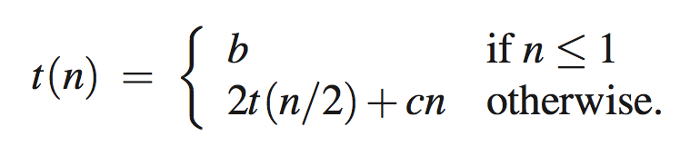
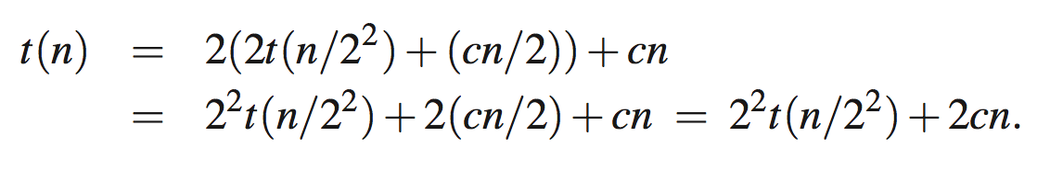

Another Analysis: Recurrence Equation (1)
t (n): the worst-case running time of merge-sort
For simplicity, n is a power of 2. Then, we have the following:
How to compute the order of t(n)?
Applying the equation recursively,
We get the following general equation:
We stop this when n/2^{i} =1, i.e., i = log n

Slide 20
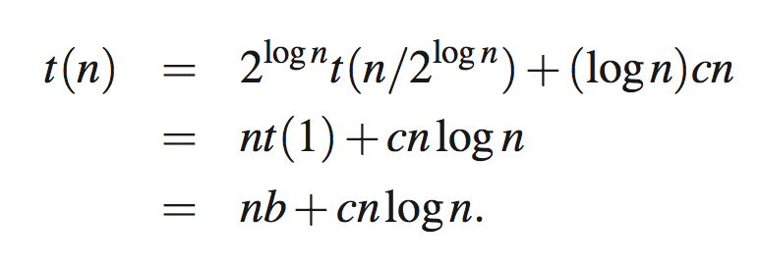
Another Analysis: Recurrence Equation (2)
Then, we have the following, and thus we are done.

Slide 21
Summary of Sorting Algorithms
Algorithm | Time | Notes
selection-sort | O(n²) | slow in-place for small data sets (< 1K)
insertion-sort | O(n²) | slow in-place for small data sets (< 1K)
heap-sort | O(n log n) | fast in-place for large data sets (1K — 1M)
merge-sort | O(n log n) | fast sequential data access for huge data sets (> 1M)

